Slide 1
Build Real-Time Controller Code (Exercise-2)

Slide 2
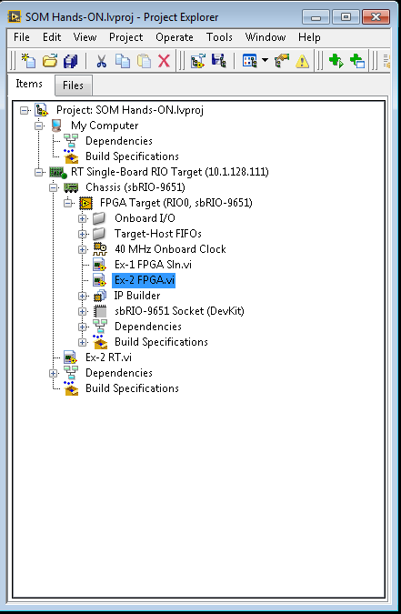
Explore the LabVIEW Project
Explore the project and expand the hierarchy on the project
DETAILED INSTRUCTIONS:
Expand of the Exercise 2:
This project contains the System on Module (sbRIO-9651) system and CLIP required for this exercise.
To expand the hierarchy and reveal the contents of the project, click the “+” boxes next to each part of the sbRIO system and measurement modules listed.
Host Computer
RT Target
FPGA Target
FPGA Code

Slide 3
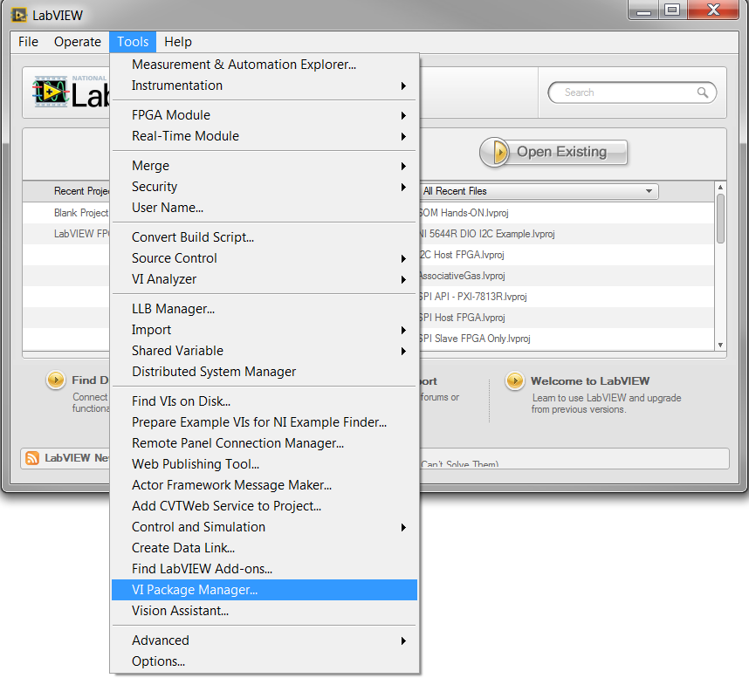
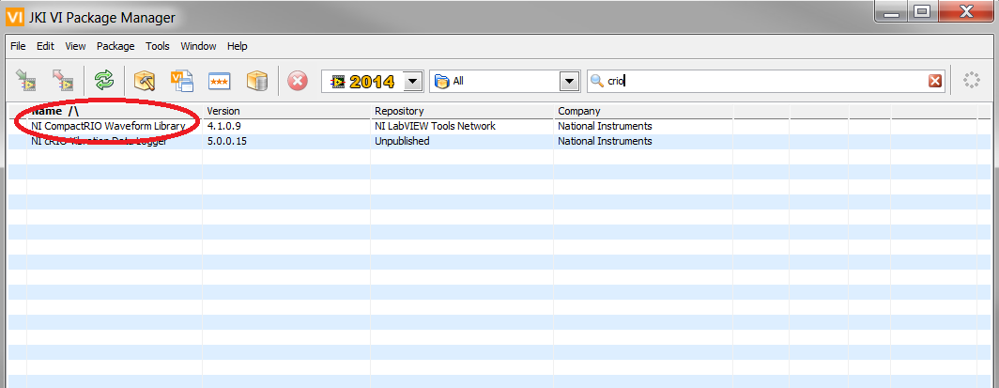
Install cRIO Waveform Library (Required Component)
DETAILED INSTRUCTIONS:
Open the VI Package Manager
Navigate to Tools >> VI Package Manager to open the VI Package Manager
Search for “cRIO”
To install cRIO Waveform Library, search for “crio”.
Find NI Compact RIO Waveform Library in the list.
We will use this library for rest of our exercise as it has both FPGA and RT code templates which will reduce code development for Acquisition Projects on Real-Time OS.

Slide 4
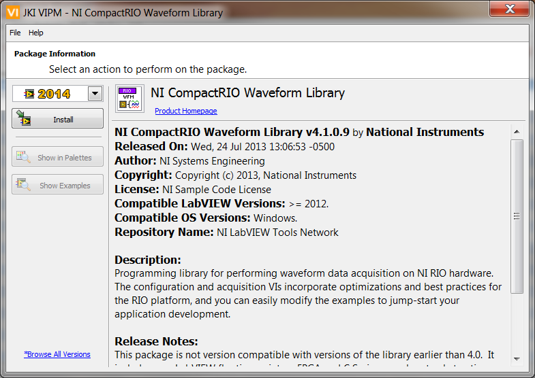
Install cRIO Waveform Library (..Contd)
DETAILED INSTRUCTIONS:
Open the Installer
Double Click on the “NI CompactRIO Waveform Library” in VI Package Manager to start the installer
Install the Package
Click on the install button to start installation of waveform library
Accept License Agreement to continue with installation
Click finally on “Finish” button to finish installation
<Double Click>

Slide 5
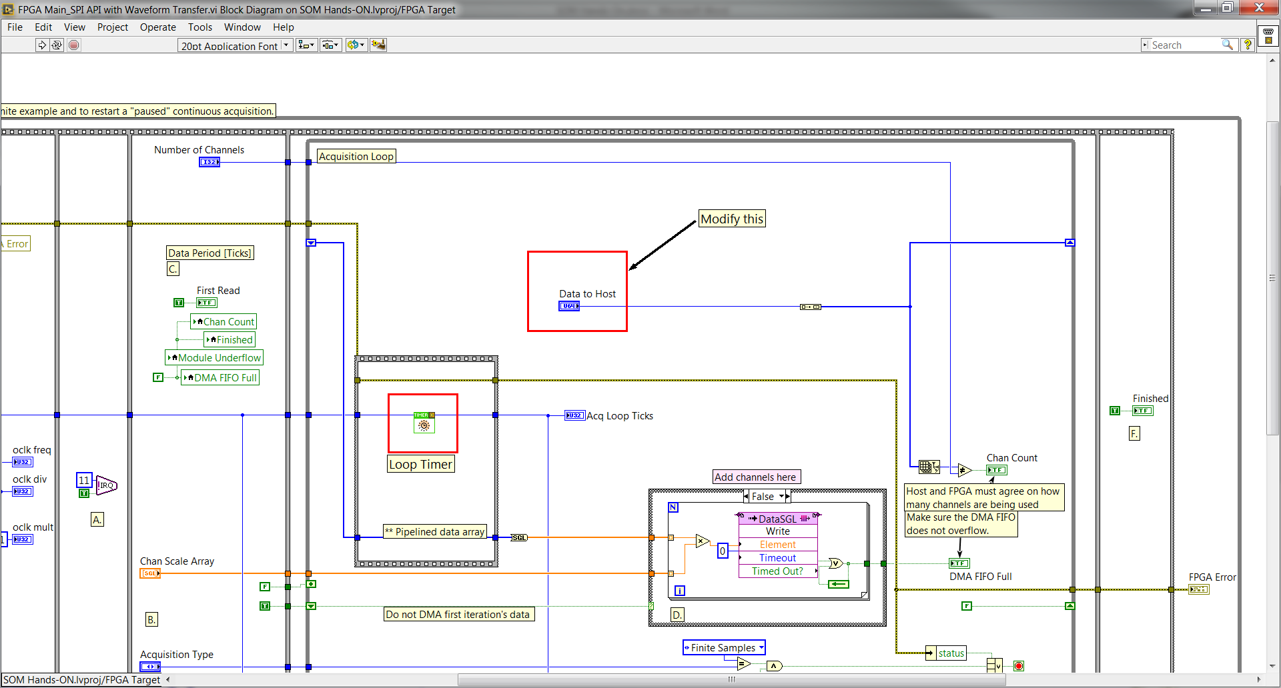
Open the Ex-2 FPGA.vi and look at its block diagram
The Ex-2 FPGA.vi is located under the FPGA target in the hierarchy. This VI already contains timing code to use for this exercise.
A. Initialization
DETAILED INSTRUCTIONS:
Open the Ex-2 FPGA.vi
Double-click on the file named Ex-2 FPGA.vi located under the FPGA target in the hierarchy as shown in Figure A
Open the Block Diagram The block diagram contains a While Loop with a sequence structure embedded to enforce loop timing. The cRIO waveform has nice template with sequences
Initialization State
Interrupt to inform start of FPGA to Real-Time OS
Acquisition Loop
We will modify this FPGA VI to acquire input from a microphone using the content from previous exercise.
B. Interrupt to Real-Time OS
C. Acquisition Loop
Placeholder for Analog Input
Timer to control
Acquisition timing
DMA FIFO to Transfer Data to
Host

Slide 6
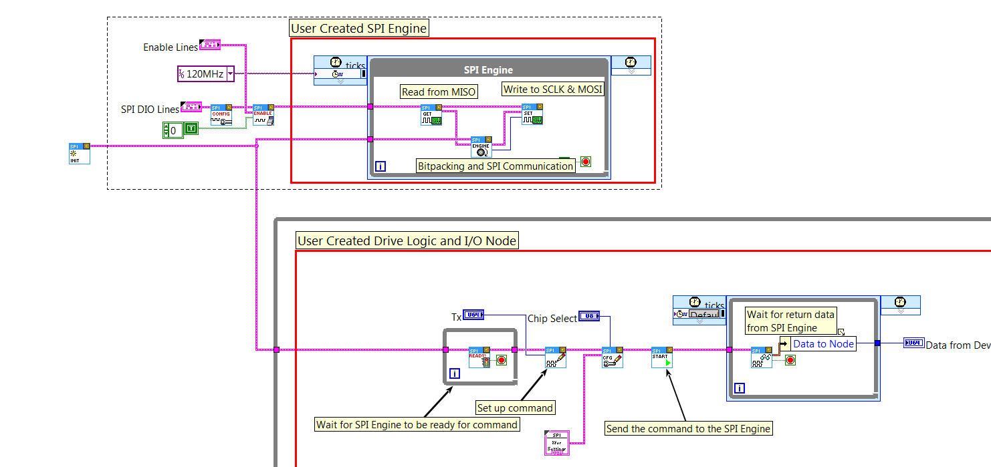
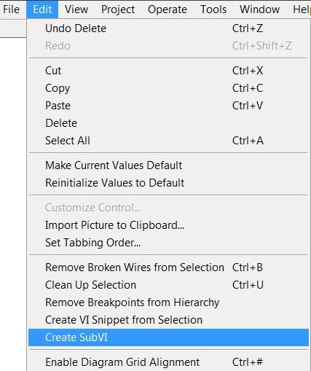
Create “SPI Engine Microphone ADC” subVI
Group SPI Engine on FPGA into subVI
DETAILED INSTRUCTIONS:
Open the Ex-1 FPGA Soln.vi
Double-click on the file named Ex-1 FPGA.vi which is located under the FPGA target in the hierarchy as shown in Figure A
Select Highlighted Code
Select the code highlighted with red box in the picture to create subVI. To create subVI from the selected section, navigate to Edit >> Create subVI after the selecting the highlighted code

Slide 7
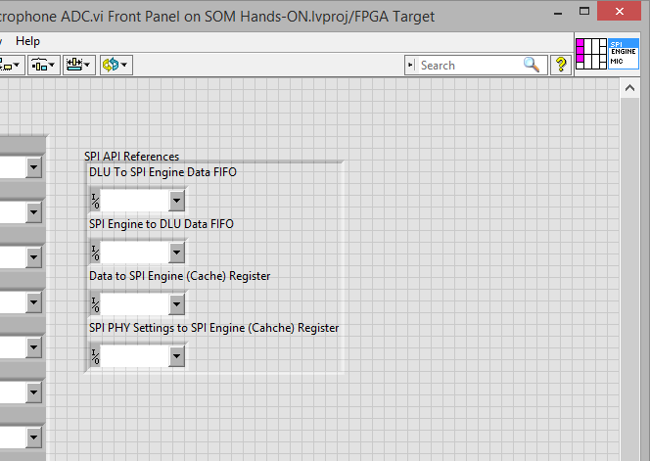
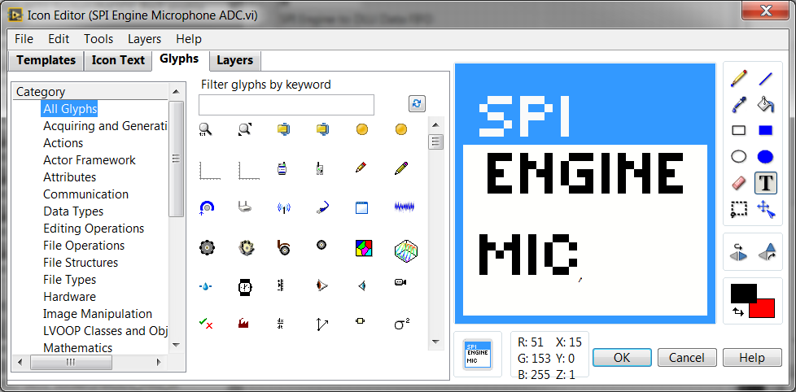
Modify “SPI Engine Microphone ADC.vi” subVI Front Panel
Modify the Front Panel interface of “SPI Engine Microphone ADC.vi”
Enable Lines
DETAILED INSTRUCTIONS:
Save the subVI as SPI Engine Microphone ADC
Change the Front Panel Connector Interface
Modify the interface by assigning the appropriate controls on the front panel.
Modify the Icon of the subVI
Change the icon name to “SPI CMDS MIC” as shown in the picture
DIO Lines
SPI References

Slide 8
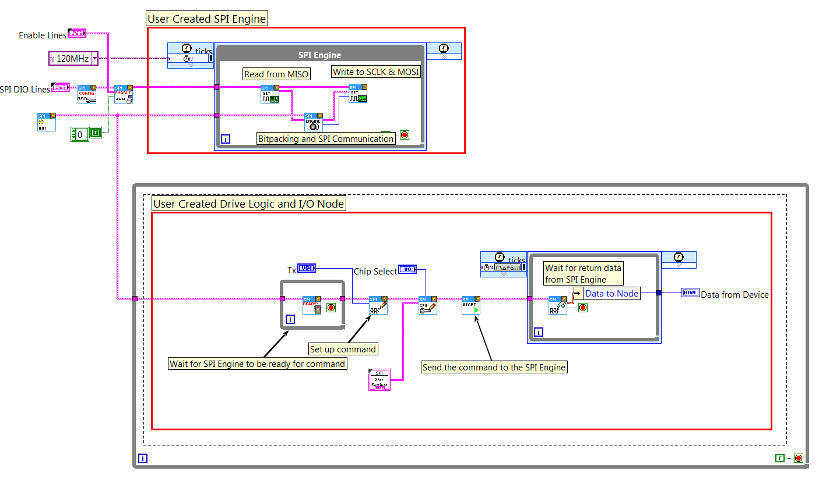
Create “SPI Commands Microphone ADC” subVI
DETAILED INSTRUCTIONS:
Open the Ex-1 FPGA.vi
Double-click on the file named Ex-1 FPGA.vi is located under the FPGA target in the hierarchy
Open the Block Diagram
Change the SPI PHY Settings control to a constant, and set the defaults of the constant to match the settings that worked in Exercise 1.
Select the code highlighted with red box in the picture to create subVI. To create subVI from the selected section, navigate to Edit >> Create subVI after the selecting the highlighted code

Slide 9
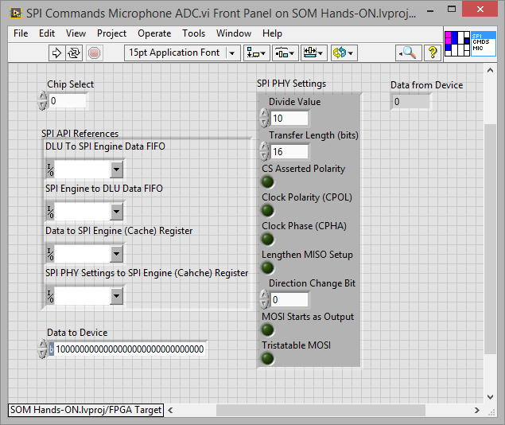
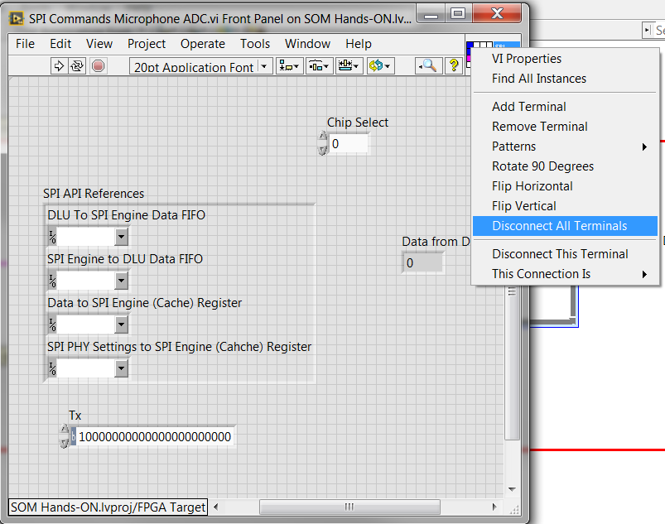
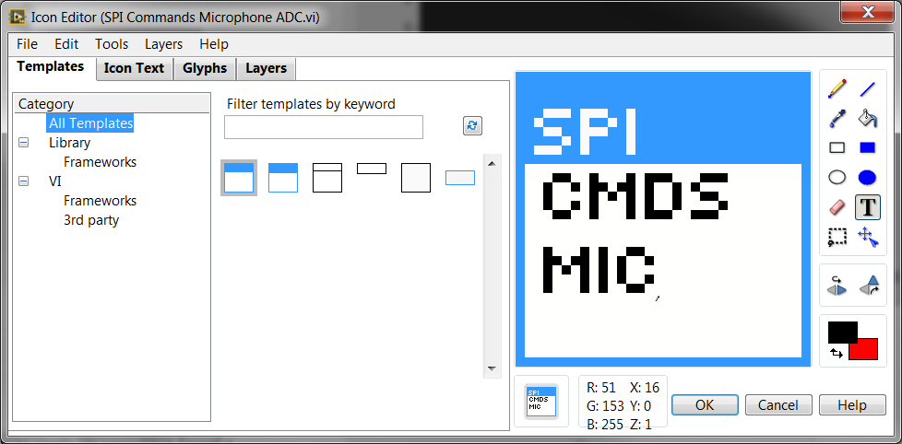
Reconnect all the Front Panel Components
SPI API References
DETAILED INSTRUCTIONS:
Disconnect all Terminals
Right Click on the Icon in the right corner, select “Disconnect all terminals”
b) Create Front Panel Interface
Connect Front Panel Controls as shown in picture
SPI References to top left
SPI PHY Settings to left side, second from Top
Chip Select to Middle Top
Data To Device bottom left
Data From Device right side
c) Repaint subVI Icon
Repaint subVI Icon as shown in picture and give a name
“SPI CMDS MIC” as shown in the picture
SPI PHY Settings
Chip Select
Data From
Device
Data To
Device

Slide 10
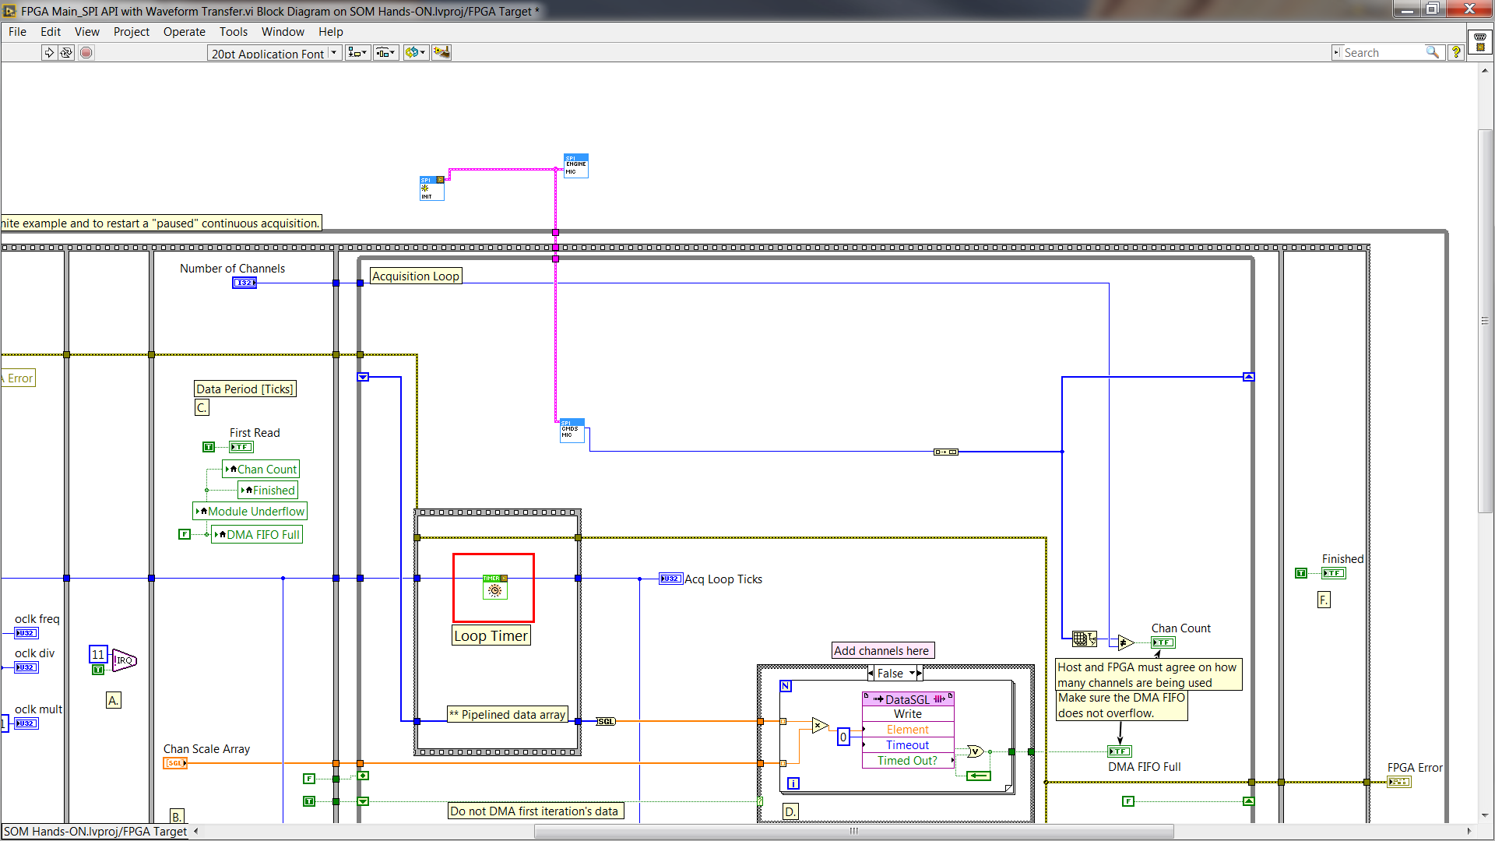
Add SPI Components to Ex-2 FPGA
Initialize SPI Internal References.vi
DETAILED INSTRUCTIONS:
Add SPI Components to Ex-2 FPGA Block Diagram
Copy the following components from Ex-1 FPGA to Ex-2 FPGA
“SPI Engine Microphone ADC.vi”
“SPI Commands Microphone ADC.vi”
“Initialize SPI Internal References.vi”
Connect “SPI API Internal References”
Wire the SPI API Internal Reference of Initialize SPI Internal References.vi input to the same named input of SPI Engine Microphone ADC.vi and SPI Commands Microphone ADC.vi
Connect SPI PHY Settings to SPI CDMS SubVI.
SPI Engine Microphone ADC.vi
SPI Commands Microphone ADC.vi
SPI API Internal References

Slide 11
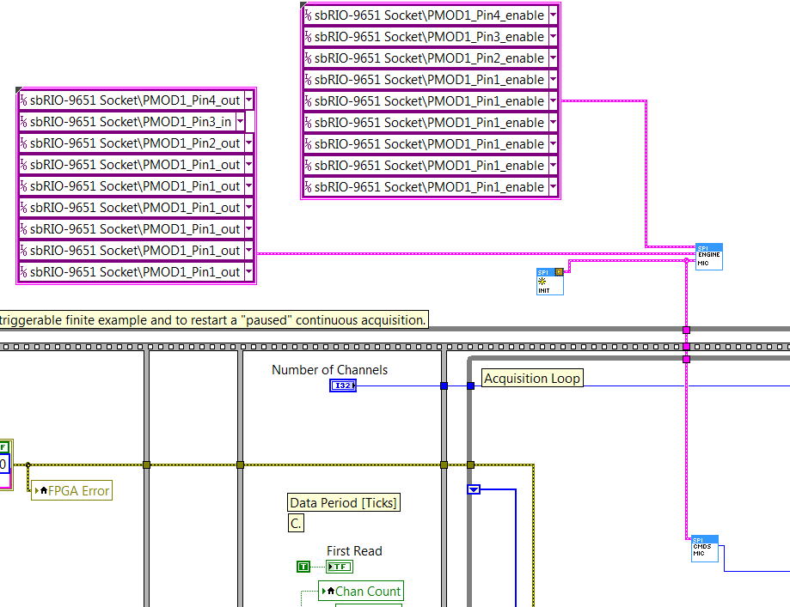
Completed Picture of FPGA Code
DETAILED INSTRUCTIONS:
Create Constant for I/O Terminal
Right Click on the “” Terminal of SPI Engine and create constant. Select the appropriate I/O terminals to match the ones in Ex-1
Create Constant for I/O Terminal Enable
Right Click on the “” Terminal of SPI Engine and create constant. Select the appropriate I/O terminals to match the ones in Ex-1
Select the correct terminals to match Ex-1 I/O lines
Select the I/O terminals and enable terminals to match Ex-1. This is crucial step, it is very common to do simulation at this step to verify correctness of the code.
Check Completed FPGA Code
Check to ensure that final FPGA Code matches the picture shown in left
I/O constant for SCLK, CS, MOSI,MISO Enable Lines
I/O constant for SCLK, CS, MOSI,MISO

Slide 12
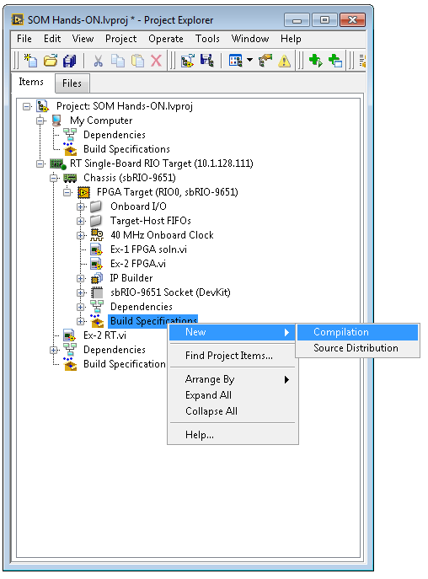
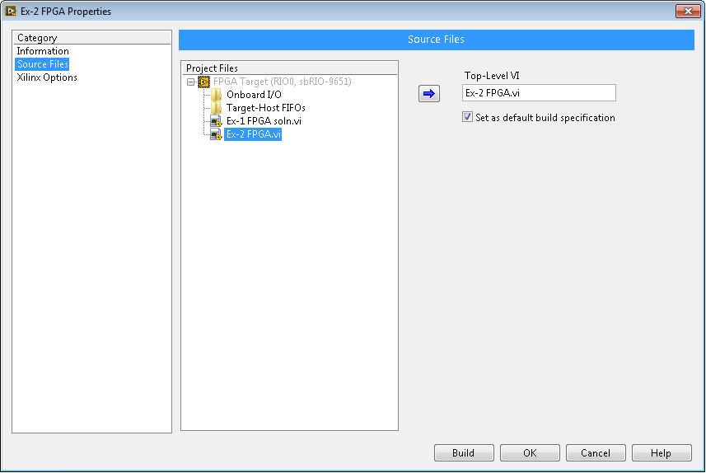
Compile the FPGA Code
Fug
DETAILED INSTRUCTIONS:
Save the EX-2 FPGA.vi
Press <Ctrl+S> or go to File » Save.
Compile the EX-2 FPGA.vi
Navigate to the Build Specifications category under the FPGA hierarchy. Expand this category and right-click on the existing FPGA VI and select Build as shown in Figure A
Figure A
Figure B

Slide 13
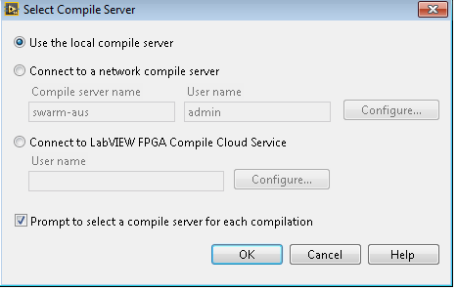
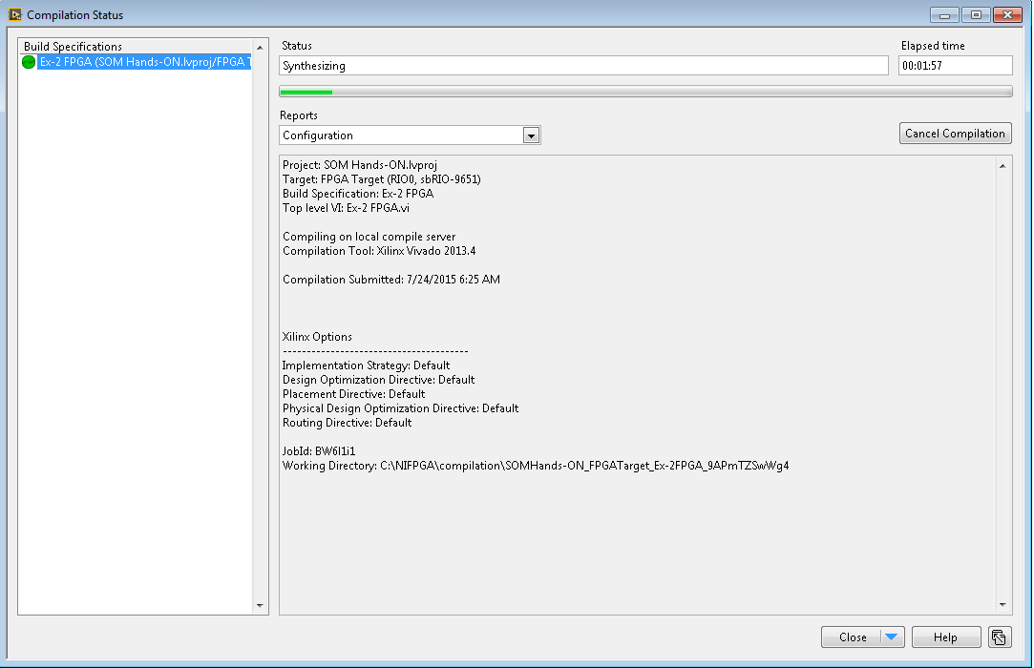
Compile the FPGA Code
DETAILED INSTRUCTIONS:
LabVIEW prompts you to select the compile server. Select the local compile server and click OK as shown in Figure C. This will start the compilation process.
During the compilation process, LabVIEW generates intermediate HDL files that are later processed by the Xilinx Compiler, which outputs a bitfile containing the placing and routing information of the FPGA design.
The compilation process for this VI takes about 15 minutes. Once you have reached the Compilation Status window, as shown in Figure C, PROCEED TO next part to start developing the real-time portion of the application.
Figure C
Figure D

Slide 14
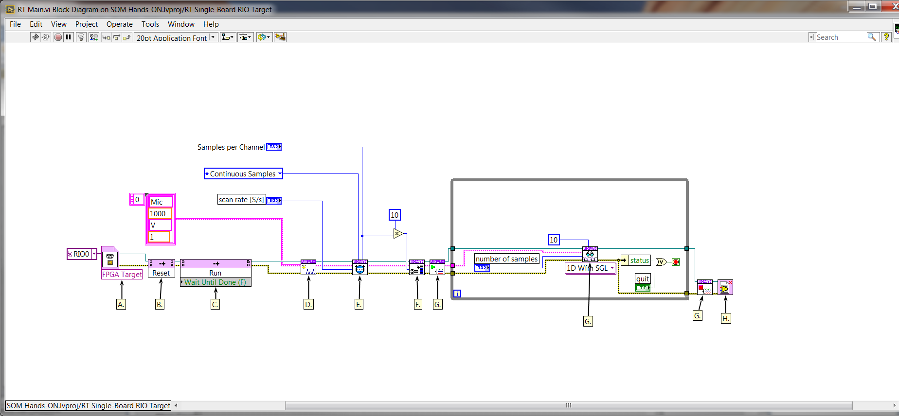
Open the Ex-2 RT.vi and look at its block diagram
The Ex-2 RT.vi is located under the RT Target in the hierarchy. This file contains the user interface and the block diagram.
DETAILED INSTRUCTIONS:
Open the Ex-2 RT.vi
Double-click on the file named Ex-2 RT.vi is located under the Real-Time target in the hierarchy as shown in Figure A
Open the Block Diagram
Look at the comments on the block diagram to understand the contents of the program. The flow of program should be similar to DAQmx.
We will modify this Ex-2 RT. vi to acquire input from a microphone after modifying the FPGA code.
Waveform Acquisition Code on RT using cRIO Waveform Library

Slide 15
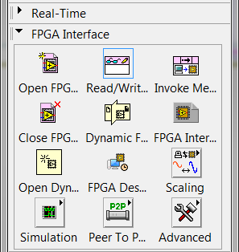

Modify the Ex-2 FPGA Code to add SPI Code
Add SPI Configuration Property Node before Create Channel.vi
DETAILED INSTRUCTIONS:
Add FPGA Property Node
Place Read/Wrote Property Node on the block diagram by opening the Functions Palette and navigate to FPGA Interface >> Read/Write Property Node.
Insert FPGA Property Node
Wire the output reference from the Run Method to the input reference of FPGA property node and then wire property method reference output to create channel.vi. Similarly, wire the error clusters to both sides of FPGA property node.

Slide 16
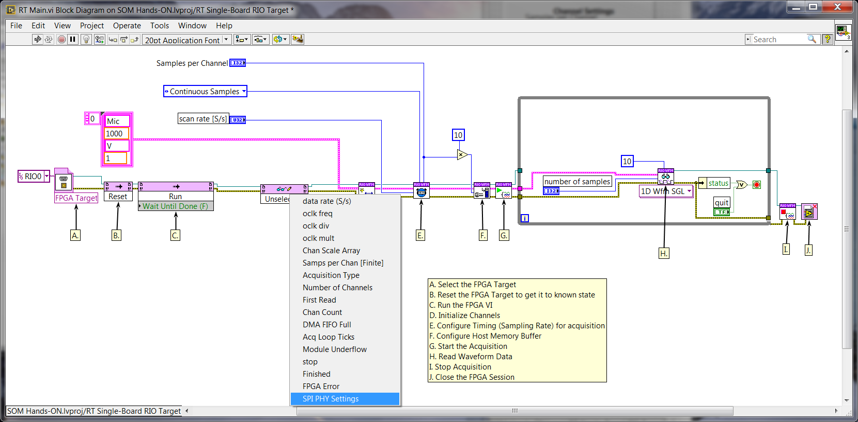
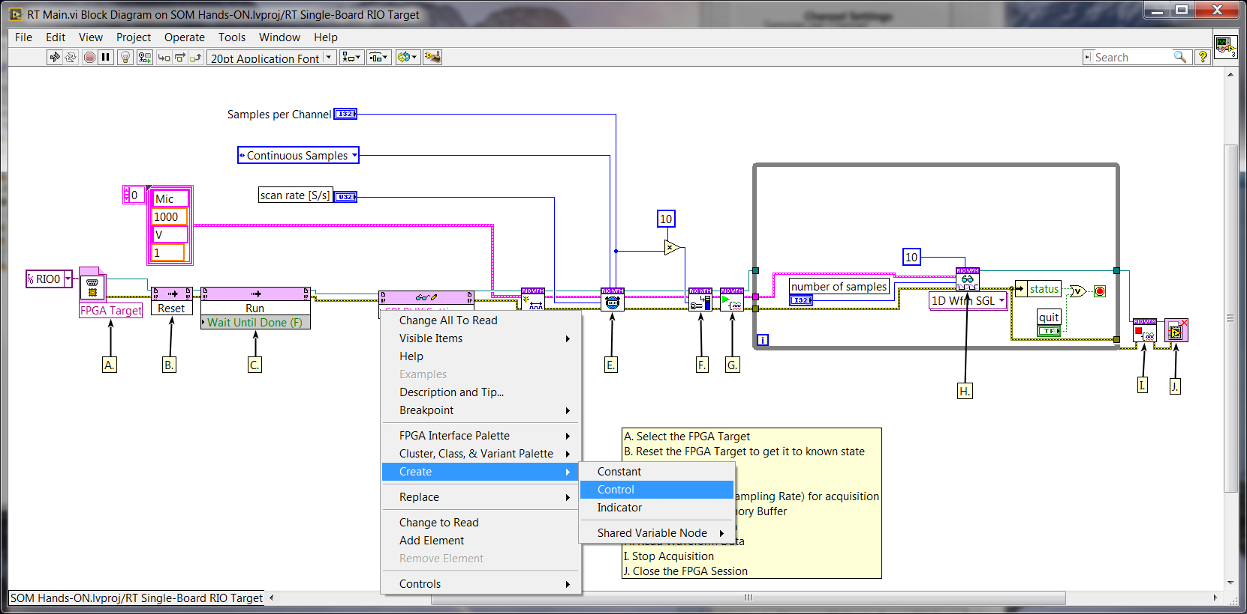
Modify the Ex-2 RT Code to add SPI Attributes
DETAILED INSTRUCTIONS:
Modify Property Node
Right click on the property node and select “SPI PHY Settings”
Create Control for SPI PHY Settings
Right click on the “SPI PHY Settings” and create control

Slide 17
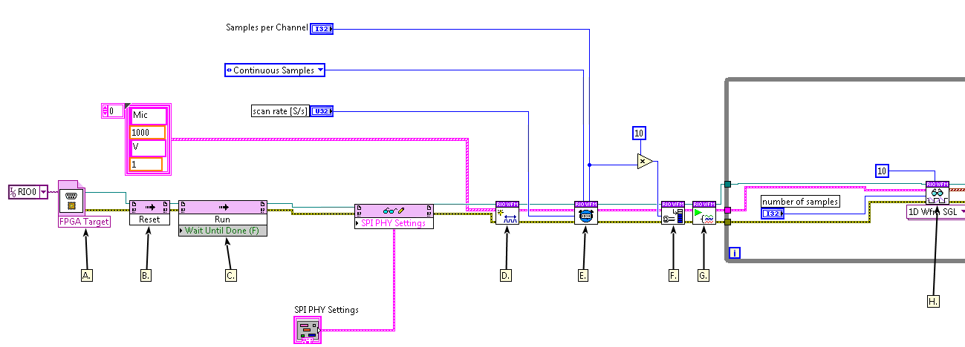
Completed Picture of RT Code
DETAILED INSTRUCTIONS:
Modify Property Node
Right click on the property node and select “SPI PHY Settings”
Create Control for SPI PHY Settings
Right click on the “SPI PHY Settings” and create control
SPI Settings can be adjusted
to meet microphone requirements

Slide 18
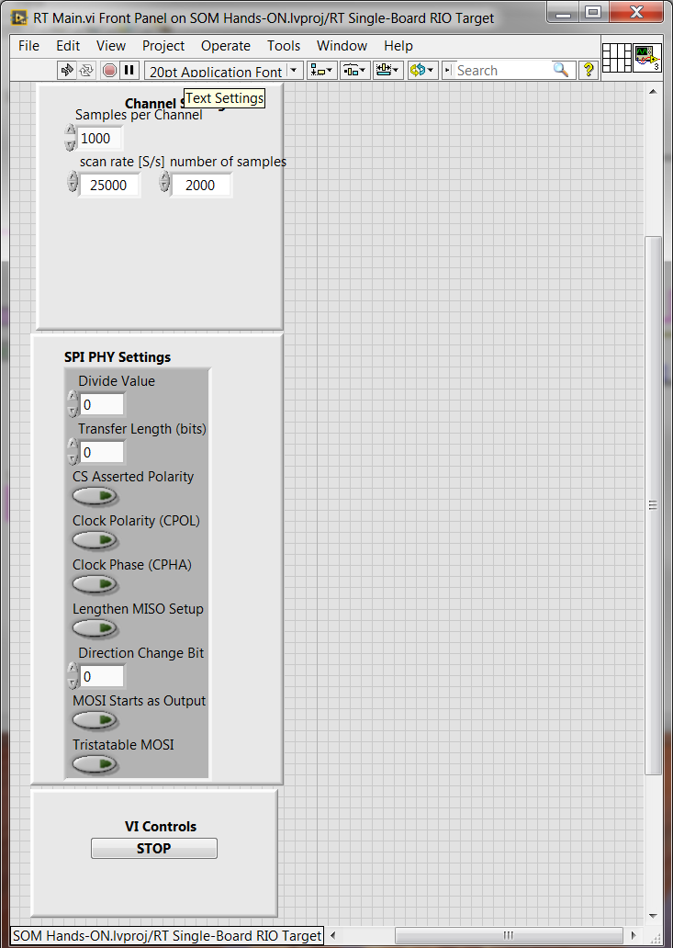
Run the RT code
DETAILED INSTRUCTIONS:
Modify SPI PHY Settings
Modify the “SPI PHY Settings” on the front panel to match the settings in Ex-1.
Run the Real-Time Code
After the FPGA Code is compiled, run “Ex-2 RT” Code
to acquire waveforms
Modify these settings
to match with the
Microphone requirements

Slide 19
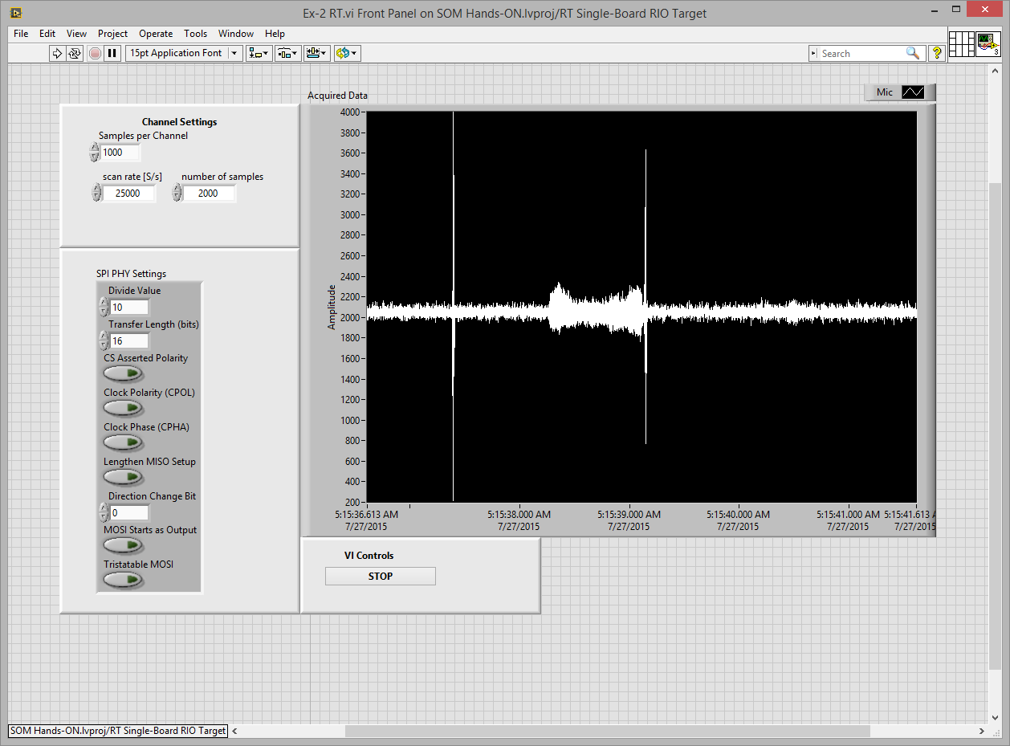
End of Exercise-2
DETAILED INSTRUCTIONS:
Collect waveforms
If you are able to collect waveforms as shown in Figure A, you are done with Exercise-2
Congratulations on finishing Exercise-2 !

